Slide 1
Lecture Module 2: EEG Basics
NDCLab
Florida International University
George Buzzell does not take credit for any of the images presented in these lecture slides. If not otherwise indicated, all images were sourced from materials available from Steven J. Luck, Michael X. Cohen, or identified through generic google image searches. Appropriate credit for all images/figures can be identified through a reverse image search or by requesting this information directly from George Buzzell at gbuzzell@fiu.edu. The theory presented in these lectures are taken predominantly the EEG books and videos by Michael X. Cohen and Steven J. Luck, as well as the PURSUE initiative. Note that all use of PURSUE initiative materials are appropriately cited.

Slide 2
Module overview
What is cognitive neuroscience?
What is EEG?
How do we use EEG?
Digging deeper into what EEG is and how it is measured
Following module: Our EEG systems

Slide 3
What is Cognitive Neuroscience?

Slide 4


Cognitive Psychology Links Cognitive Processes and Behavior
Cognitive
Processes
Behavior
“There’s a bear behind you”
B
Localize
Bear
A
Motor Output “Run!”
Understand
Words
D
C
Recognize
Bear
Adapted From “PURSUE Introduction to EEG/ERP”. [PowerPoint Presentation] by C. M. Bukach, J. W. Couperus, & C. L. Reed, 2020, www.pursueerp.com. CC BY-NC-SA.
Notes:
ALTERNATIVE 1: From Words to Action
Cognitive Psychology links cognitive processes and behavior.
Cognitive Psychology is the study of mental functions and their role in behavior. Mental functions include memory, learning, perception, attention, reasoning, language, etc. A simple task such as understanding a sentence and deciding on a response involves many mental functions, and each of these functions may be broken down into several cognitive components or processes. Cognitive Psychology models these cognitive processes and their organization.
To provide a simplified example, imagine your friend tells you “There’s a bear behind you.”
What are some of the cognitive functions that must occur before we can run?
CLICK: First we must understand the sentence. This would involve a complex set of processes related to perception and linguistic processing.
CLICK: Second, we must figure out where the bear is, in order to run in the right direction.
CLICK: We would also need to use recognition processes to identify the bear when it comes into our field of vision. Recognition and Localization processes may happen at the same time.
CLICK: Finally, we must determine what action to take and send action signals to our muscles to run.
The outcome of this cognitive processing stream influences our thoughts, emotions, and our actions!
Image Credits:
Person with speech bubble. From Speech balloon talk bubble [ClipArt] by [Peggy_Marco], n.d., Pixabay (https://pixabay.com/illustrations/speech-balloon-talk-bubble-1019777/). CC0 1.0.
People running. From Competition race sport run [ClipArt] by [Peggy_Marco], n.d., Pixabay (https://pixabay.com/illustrations/speech-balloon-talk-bubble-1019777/). CC0 1.0.

Slide 5
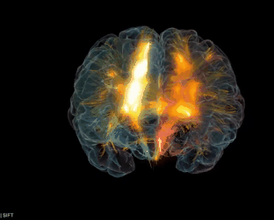
Cognitive Neuroscience Links Brain to the Cognitive Processes Underlying Behavior
Brain
Cognitive
Processes
Behavior
“There’s a bear behind you”
B
Localize
Bear
A
Motor Output “Run!”
Understand
Words
D
C
Recognize
Bear
Adapted From “PURSUE Introduction to EEG/ERP”. [PowerPoint Presentation] by C. M. Bukach, J. W. Couperus, & C. L. Reed, 2020, www.pursueerp.com. CC BY-NC-SA.

Slide 6
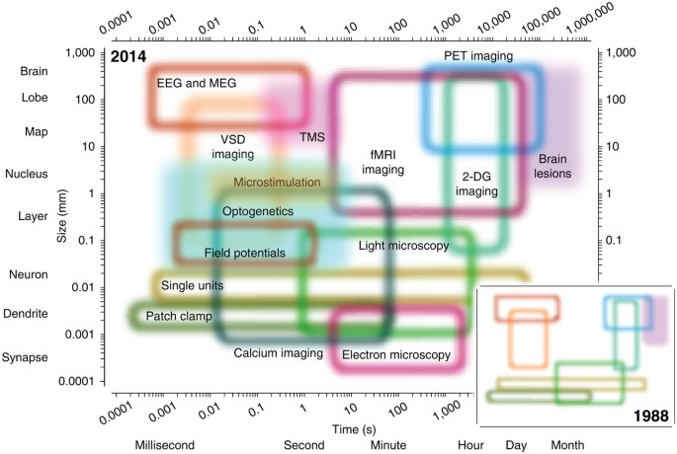
Neuroscience Methods
(Sejnowski et al., 2014)

Slide 7
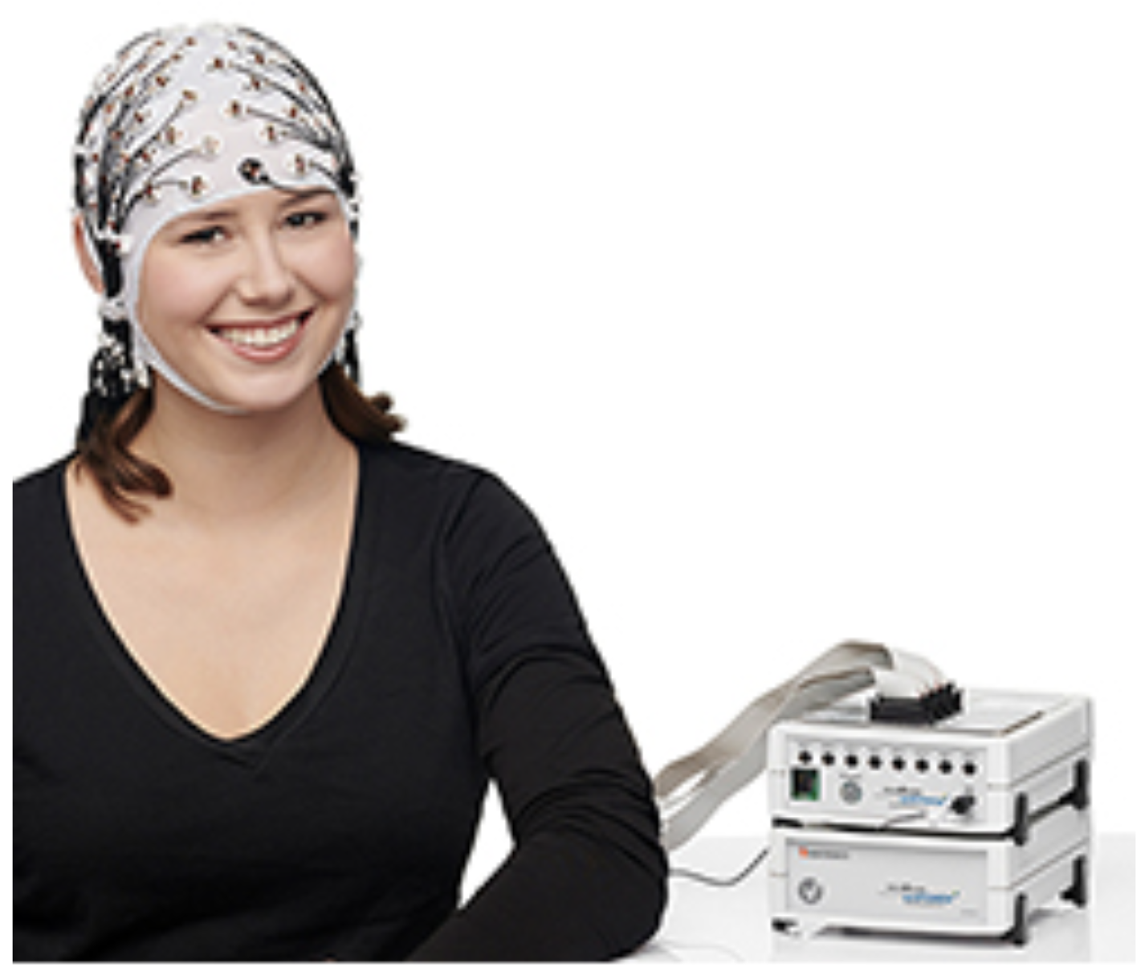

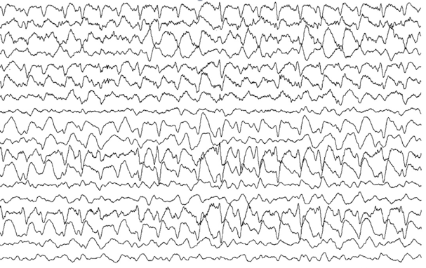
ELECTROENCEPHALOGRAPHY (EEG)
EEG is a non-invasive, direct and continuous measure of the changes in electrical potentials at the scalp produced by neural activity in REAL time.
Brain Vision EEG System
Adapted From “PURSUE Introduction to EEG/ERP”. [PowerPoint Presentation] by C. M. Bukach, J. W. Couperus, & C. L. Reed, 2020, www.pursueerp.com. CC BY-NC-SA.
Notes:
EEG is a non-invasive, direct and continuous measure of the changes in electrical potentials at the scalp produced by neural activity in REAL time.
In this picture, you can see a picture of a participant wearing a cap with electrodes. Electrodes are connected to an amplifier that amplifies and records the signal at each electrode. Each electrode produces a its own data stream tracking changes in electrical signals at its scalp location, which is displayed on a computer screen.
Let’s briefly break down some key concepts in this definition:
EEG is Non-invasive: Electrodes are not inserted into the brain.
EEG Measures Scalp potentials: Electrodes are placed on the scalp and measure changes in electric signals at the scalp.
EEG is a direct measure of brain activity: The speed of electric transmission from brain to scalp is so fast that the time lag is negligible – thus it captures brain activity in real time.
EEG is a continuous Measure: EEG tracks changes in scalp potential over time.
These last two are key advantages of the EEG Method – it has very high temporal resolution so we can see millisecond changes in brain activity as it happens.
Image Credits:
Person wearing EEG cap connected to amplifier. From CapTrak and actiCHamp by BrainVision, n.d. (https://pressrelease.brainproducts.com/wp-content/gallery/1501/CapTrak_actiCHamp_01.jpg). Copyright by Brain Vision, LLC.
Computer monitor. From Computer monitor lcd screen blank by [Clker-Free-Vector-Images], n.d. (https://pixabay.com/vectors/computer-monitor-lcd-screen-blank-303283/). CC0 1.0.

Slide 8
Neuroscience Methods
(Sejnowski et al., 2014)

Slide 9
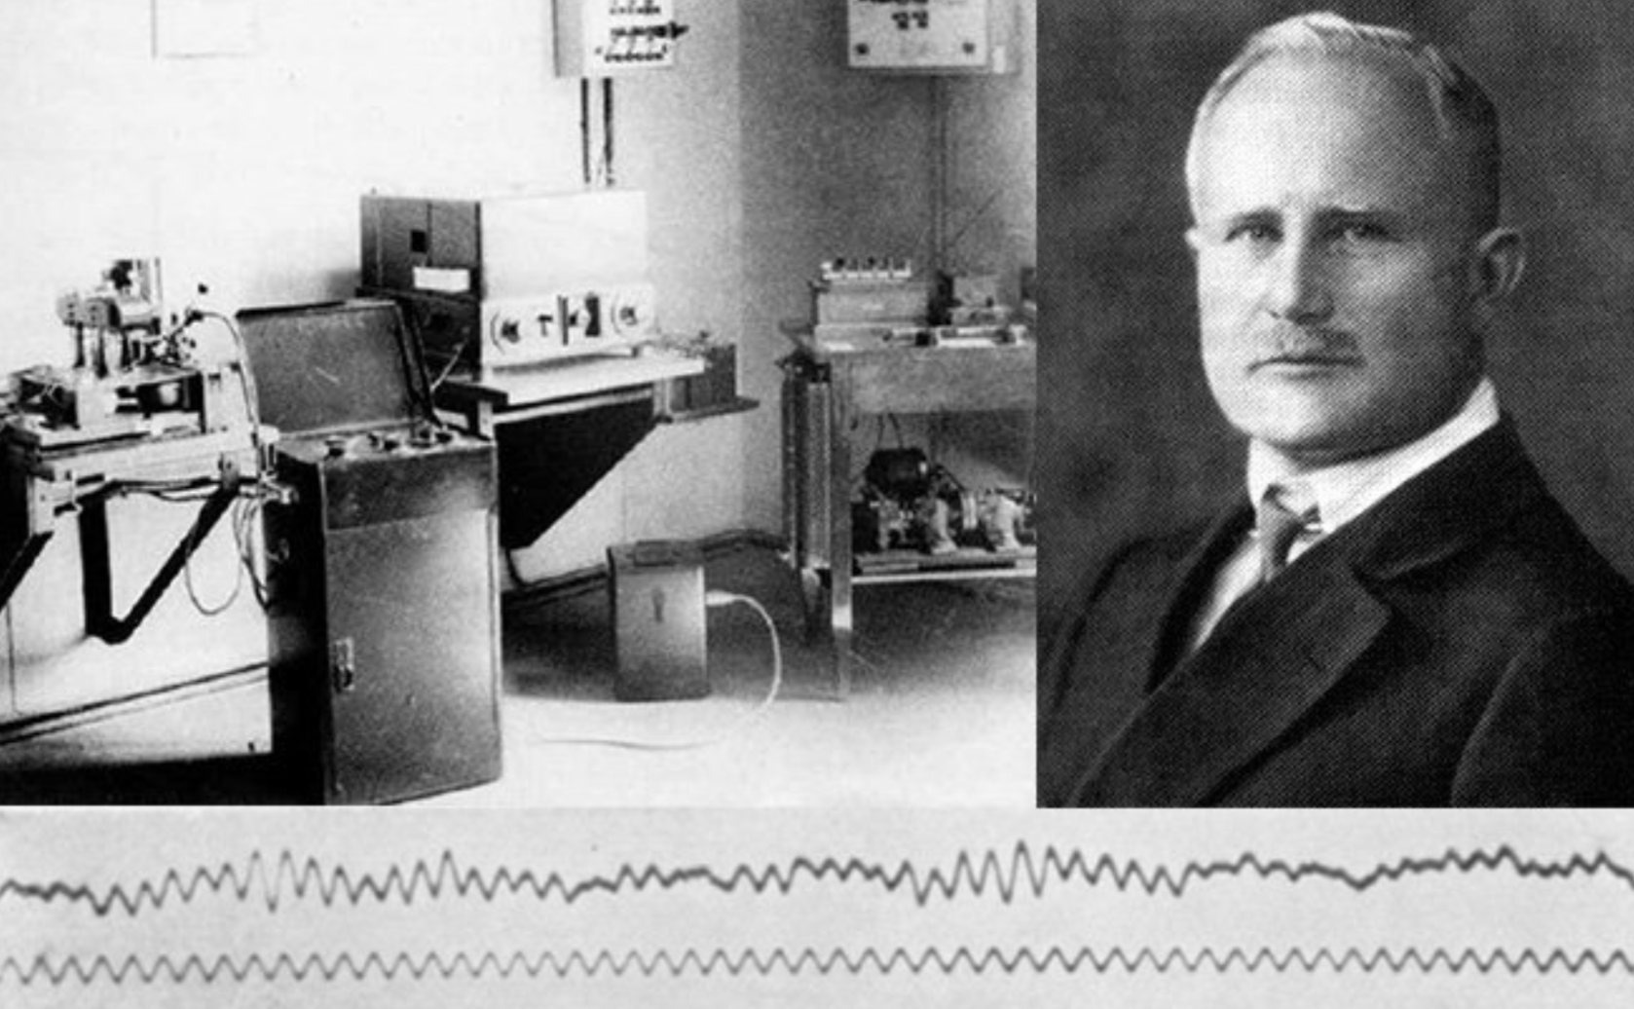
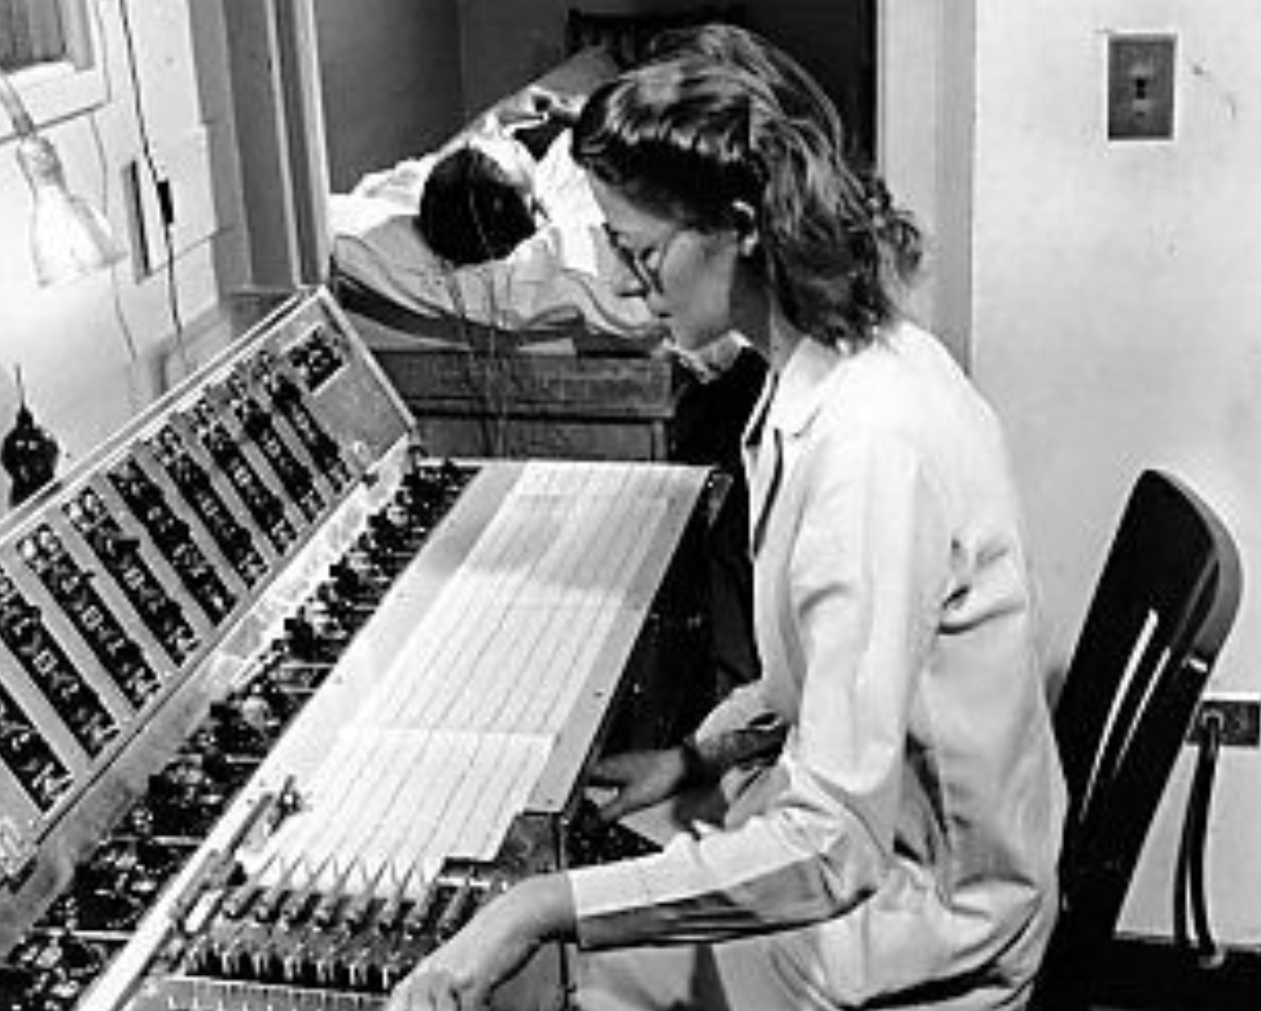
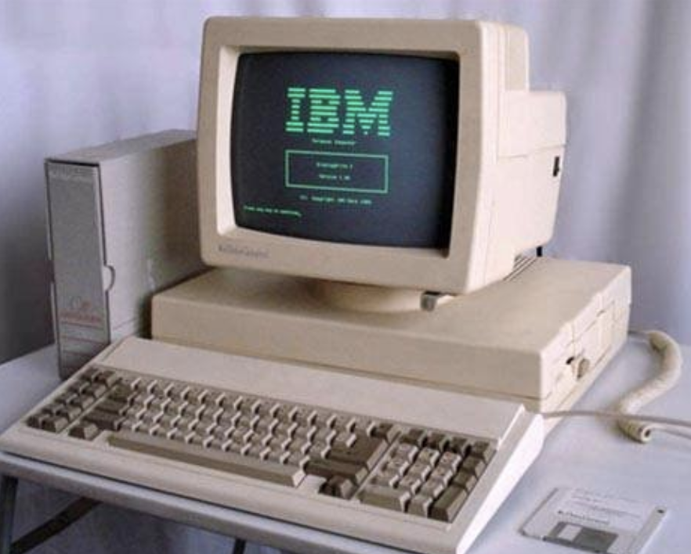
Fun facts: brief history of EEG
Hans Berger invented the EEG in 1924
Wanted to study telepathy
Discovered alpha waves
First studies using EEG to study cognition via experiments in 60s – 70s
EEG really took off in 80s via advances in computers
Initially thought fMRI might supplant EEG.
Now clear that EEG and fMRI are complementary approaches (space vs. time)

Slide 10
Interim summary
Cognitive neuroscience seeks to understand brain, mind, and behavior using non-invasive neural methods, cognitive psychology experiments, and behavioral measures
There is no perfect neural method; all have pros/cons
EEG provides a direct, real-time measure of brain activity and is our neural method of choice in the NDCLab.

Slide 11
What is EEG?

Slide 12
ELECTROENCEPHALOGRAPHY (EEG)
EEG is a non-invasive, direct and continuous measure of the changes in electrical potentials at the scalp produced by neural activity in REAL time.
Brain Vision EEG System
Adapted From “PURSUE Introduction to EEG/ERP”. [PowerPoint Presentation] by C. M. Bukach, J. W. Couperus, & C. L. Reed, 2020, www.pursueerp.com. CC BY-NC-SA.
Notes:
EEG is a non-invasive, direct and continuous measure of the changes in electrical potentials at the scalp produced by neural activity in REAL time.
In this picture, you can see a picture of a participant wearing a cap with electrodes. Electrodes are connected to an amplifier that amplifies and records the signal at each electrode. Each electrode produces a its own data stream tracking changes in electrical signals at its scalp location, which is displayed on a computer screen.
Let’s briefly break down some key concepts in this definition:
EEG is Non-invasive: Electrodes are not inserted into the brain.
EEG Measures Scalp potentials: Electrodes are placed on the scalp and measure changes in electric signals at the scalp.
EEG is a direct measure of brain activity: The speed of electric transmission from brain to scalp is so fast that the time lag is negligible – thus it captures brain activity in real time.
EEG is a continuous Measure: EEG tracks changes in scalp potential over time.
These last two are key advantages of the EEG Method – it has very high temporal resolution so we can see millisecond changes in brain activity as it happens.
Image Credits:
Person wearing EEG cap connected to amplifier. From CapTrak and actiCHamp by BrainVision, n.d. (https://pressrelease.brainproducts.com/wp-content/gallery/1501/CapTrak_actiCHamp_01.jpg). Copyright by Brain Vision, LLC.
Computer monitor. From Computer monitor lcd screen blank by [Clker-Free-Vector-Images], n.d. (https://pixabay.com/vectors/computer-monitor-lcd-screen-blank-303283/). CC0 1.0.

Slide 13



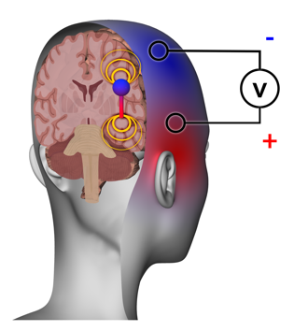
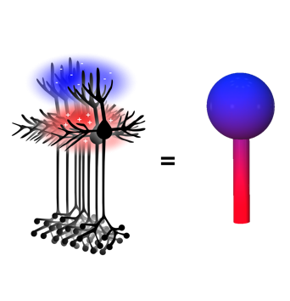
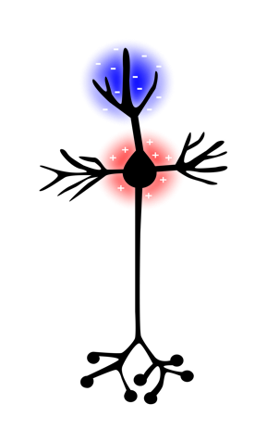
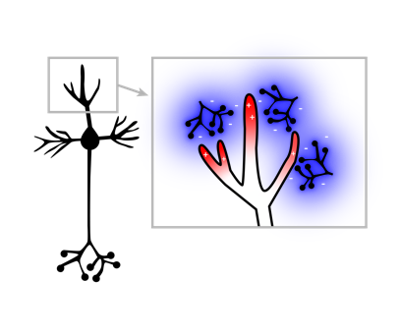
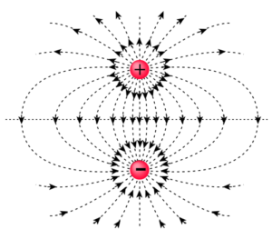
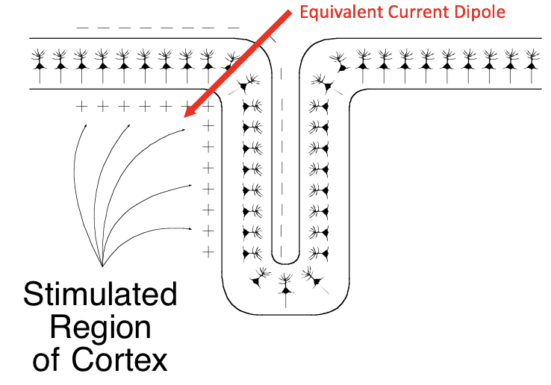
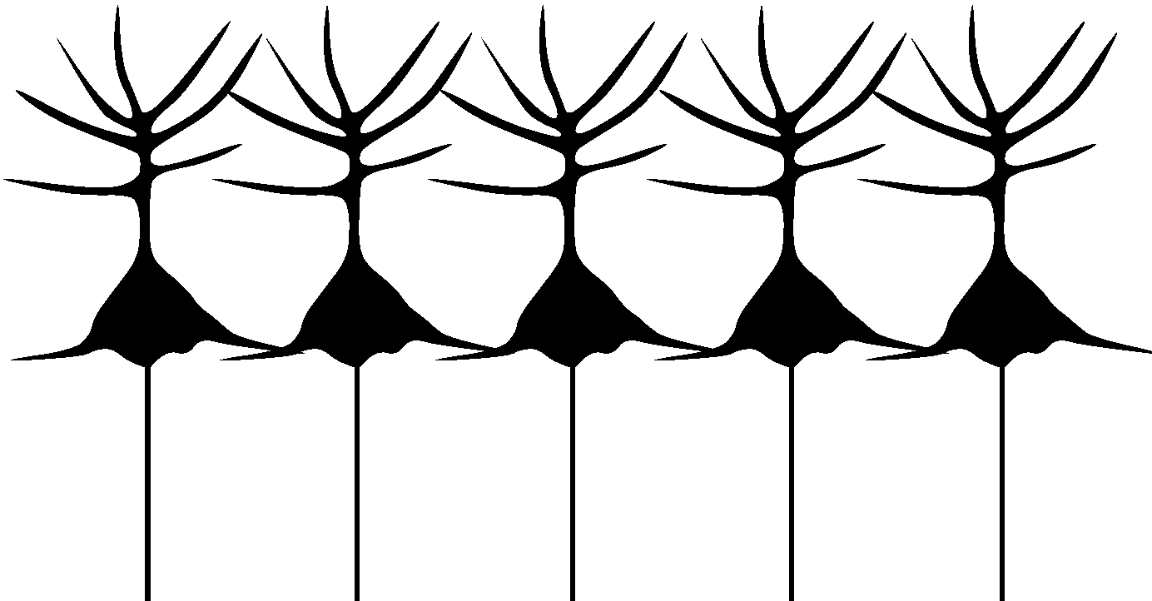
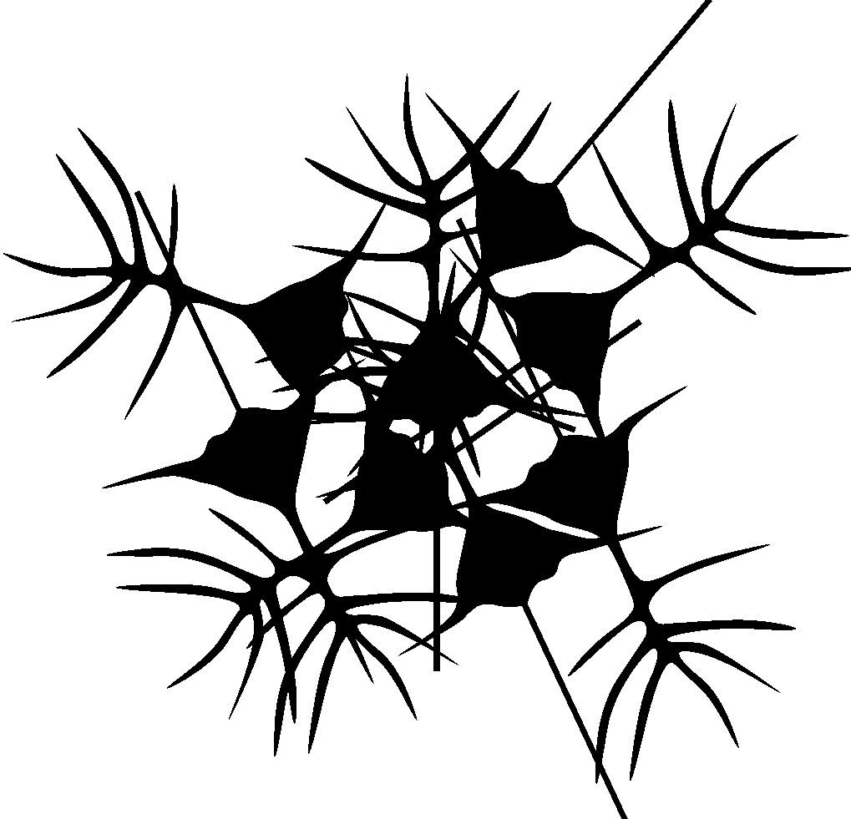
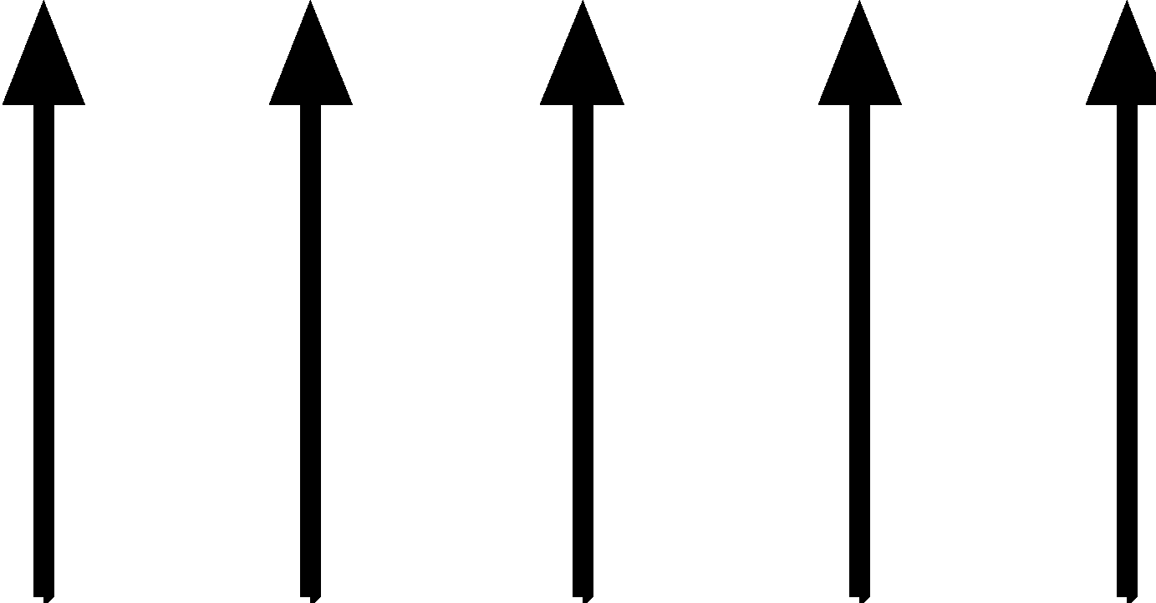
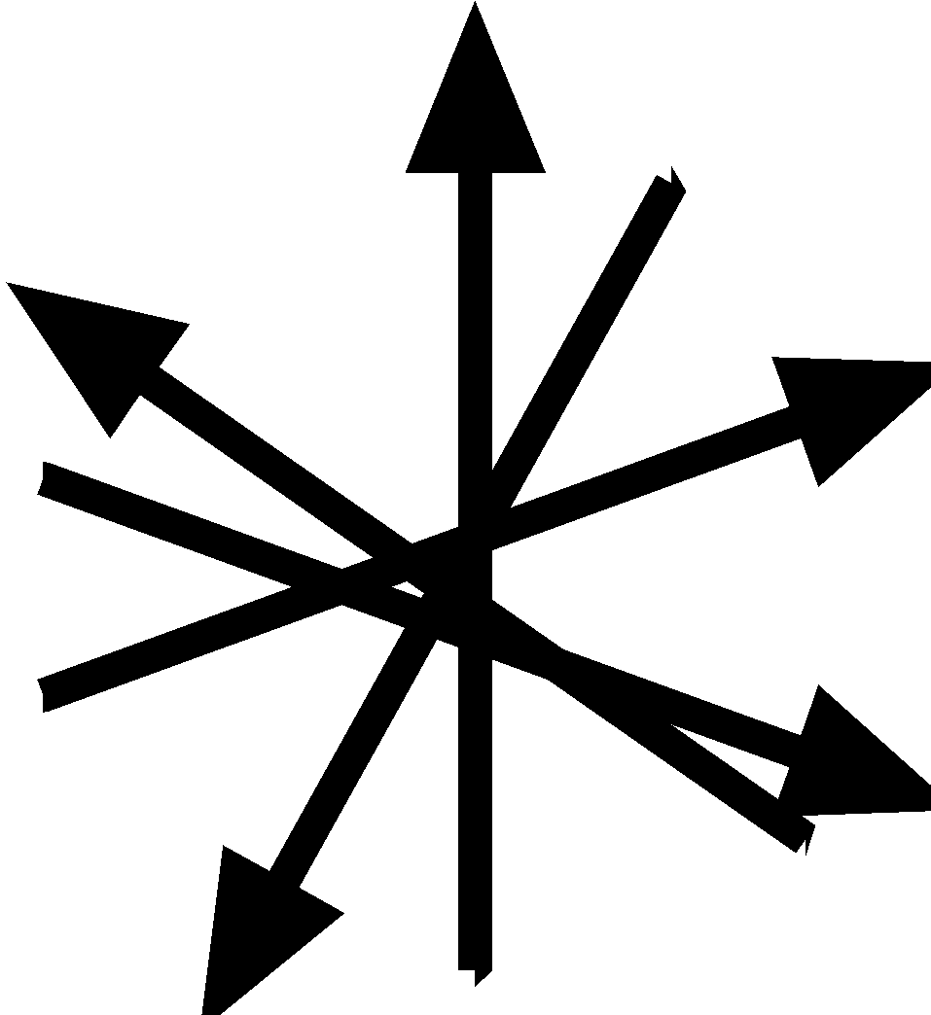
Where does the EEG Signal Come From?
EEG Waveforms
Electrodes measure changes in scalp voltage over time
Scalp Distribution
Dipole potentials spread to scalp
Summation
Synchronous dipoles from aligned neurons summate
Dipoles
A difference of charge between two parts of the neuron
Postsynaptic
Potentials
Affect local ion concentrations surrounding the cell
Laminar
Nuclei
Adapted from “PURSUE Introduction to EEG/ERP”. [PowerPoint Presentation] by C. M. Bukach, J. W. Couperus, & C. L. Reed, 2020, www.pursueerp.com. CC BY-NC-SA.
Notes:
Here we preview the basic steps of how neurons create electrical signals that are recorded by electrodes on the scalp. Then we will look at each stage in depth.
*CLICK. Post-synaptic Potentials: Neurons communicate through electro-chemical signals. Post synaptic potentials occur when a cell receives communication. Post synaptic potentials involve the exchange of charged ions between the outside and inside of the cell, creating a local changes in charge concentration in both the intracellular and extracellular fluid. For example, an excitatory PSP makes the inside of the cell more positive, as indicated in red, and the outside of the cell more negative, as indicated in blue.
*CLICK. The change of ion concentration in the extracellular fluid creates a difference in charge between the site of the Post synaptic potential and the cell body. This difference in charge creates a dipole and electrical current, similar to how a battery works.
*CLICK A dipole from a single neuron is not strong to be measured by EEG. Rather, it takes synchronous activity of an aligned cluster of cells to make a measurable EEG signal. The summed activity results in a large equivalent current dipole that can be symbolized as a circle that represents the location of the potential, and a line that represents the orientation of the dipole.
The dipole potentials disperses instantaneously through the brain and skull tissue and creates a distribution of charge on the scalp that reflects the underlying post synaptic activity. This process is called volume conduction and the result is a scalp distribution. NOTE for Instructor: The yellow lines represent equipotential lines, (voltage dispersion) not electrical field lines.
Electrodes placed on the scalp measure changes in scalp voltage over time that reflect the time course of cognitive processing. The top part of this image shows how the scalp distribution is changing over time, and the bottom graph shows the voltage value from a single electrode at each timepoint.
Resources for understanding the generation of the EEG Signal
Emilia Hagen’s 2018 Animation Links on YouTube/videos (~2-3 min videos)
Understanding potentials: https://youtu.be/0_boSag4f8g
Formation of a Dipole: https://youtu.be/rzgDOaGjjOs
Sensing dipoles: https://youtu.be/AIvlNNFQLEk
– these movies must be used and cited under the Creative Commons License with no modifications and no commercial use
Image Credits:
Postsynaptic potentials affect local ion concentrations surrounding the cell. From Postsynaptic potentials at dendrites of pyramidal neuron [Image] by L. L. Hensley, C. M. Bukach, J. W. Couperus, & C. L. Reed, 2020, PURSUE. CC BY-NC-SA 4.0.
A difference of charge between two parts of the neuron forms a dipole. From A pyramidal neuron forms a dipole [Image] by L. L. Hensley, C. M. Bukach, J. W. Couperus, & C. L. Reed, 2020, PURSUE Project. CC BY-NC-SA 4.0.
Synchronous dipoles from aligned neurons summate. From Many pyramidal neuron dipoles summate
[Image] by L. L. Hensley, C. M. Bukach, J. W. Couperus, & C. L. Reed, 2020, PURSUE Project. CC BY-NC-SA 4.0.
Dipole potentials spread to scalp. From Spread of signal from dipole to scalp [Image] by L. L. Hensley, C. M. Bukach, J. W. Couperus, & C. L. Reed, 2020, PURSUE Project. CC BY-NC-SA 4.0.
Electrodes measure changes in scalp voltage over time. From Scalp voltages [Image] by L. L. Hensley, C. M. Bukach, J. W. Couperus, & C. L. Reed, 2020, PURSUE Project. CC BY-NC-SA 4.0.

Slide 14
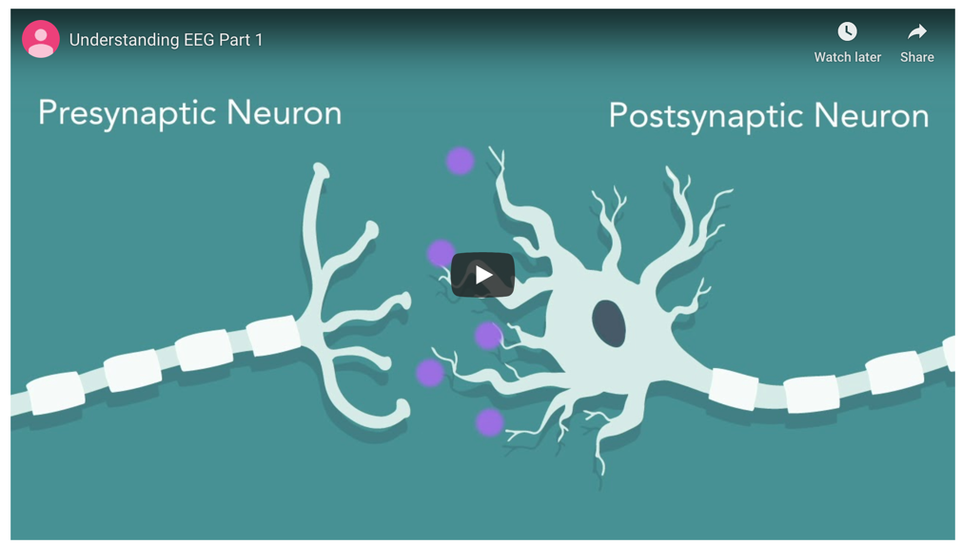
Understanding Potentials
Why is EEG better for measuring post-synaptic potentials than action potentials?
https://pursue.richmond.edu/multimedia-tools/animations/eeg-1-understanding-potentials/
From “PURSUE Introduction to EEG/ERP”. [PowerPoint Presentation] by C. M. Bukach, J. W. Couperus, & C. L. Reed, 2020, www.pursueerp.com. CC BY-NC-SA.
Notes:
The video series explains the details of how the neural signal is generated and propagated to the scalp where it can be measured by scalp electrodes.
This videos can be assigned before class or can be used as an in class activity. A handout with the questions is also available in the instructor supporting material files.
If assigned before class, have students discuss their answers to the entire 3-video series in small groups, and then share with the entire class.
If assigned in class, show each video to the whole class and have students discuss the question before sharing their answers with the entire class.
If teaching remotely using Zoom, share the video to the entire class and break into break-out rooms to discuss the question.
The first video explains how action potentials and post synaptic potentials are formed.
Answer to Question For Video 1: Understanding Potentials:
EEG is better for measuring post-synaptic potentials than action potentials because action potentials happen too quickly to summate. Post synaptic potentials last longer and this allows them to summate over time.
Image Credits:
Understanding potentials. From Understanding EEG Part 1 [Video] by E. Hagen, C. L. Reed, C. M. Bukach, & J. W. Couperus, 2019 (https://youtu.be/bUEa7H9akNk). CC BY-NC-ND.

Slide 15
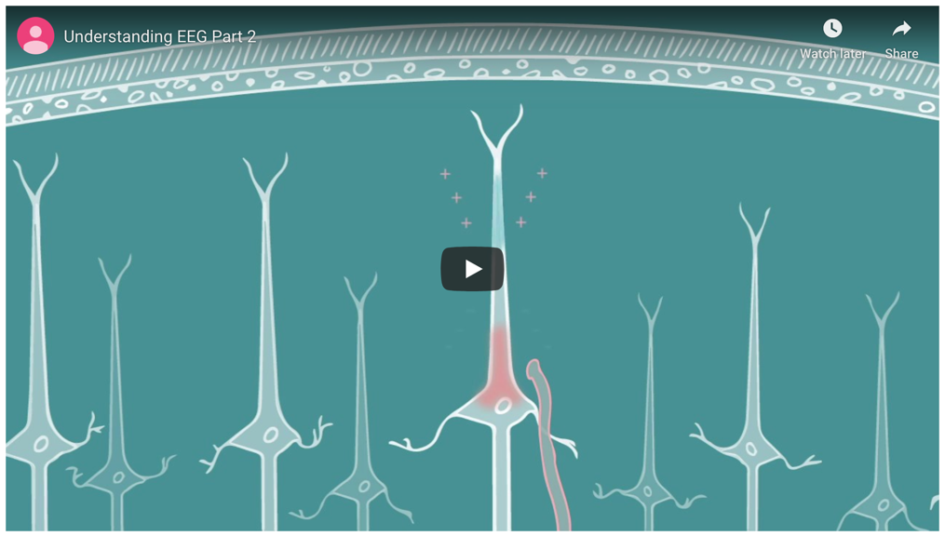
Formation of a Dipole
How does a postsynaptic potential create a dipole?
https://pursue.richmond.edu/multimedia-tools/animations/eeg-2-formation-dipole/
From “PURSUE Introduction to EEG/ERP”. [PowerPoint Presentation] by C. M. Bukach, J. W. Couperus, & C. L. Reed, 2020, www.pursueerp.com. CC BY-NC-SA.
Notes:
The second video explains who post synaptic potentials create dipoles.
Answer to question: Movement of charged ions from extracellular fluid into and out of cell during post-synaptic potential creates a difference in concentration of charged ions at the post-synaptic location. This results in a separation of charge surrounding the cell, which creates a dipole.
Image Credits:
Formation of a Dipole. From Understanding EEG Part 2 [Video] by E. Hagen, C. L. Reed, C. M. Bukach, & J. W. Couperus, 2019 (https://youtu.be/6rGpMi-mBwc). CC BY-NC-ND.

Slide 16
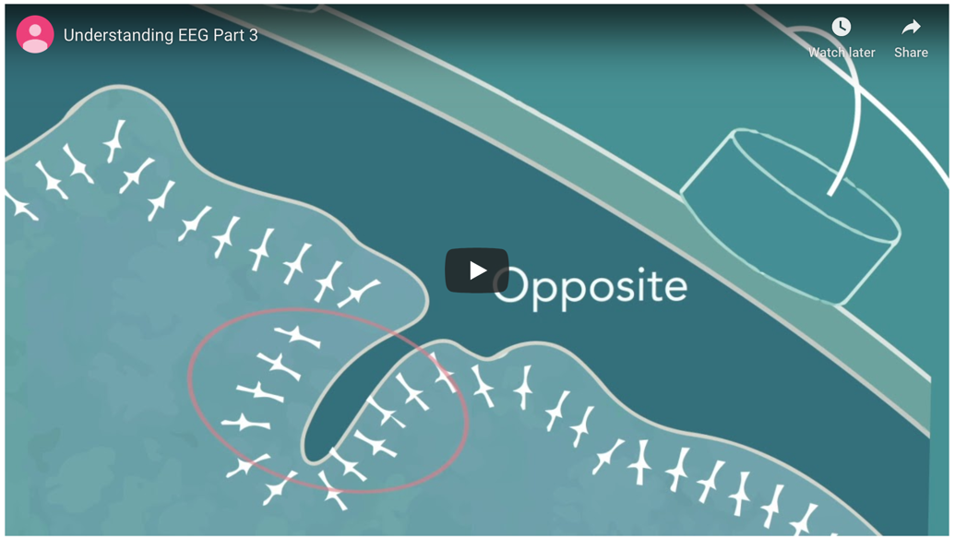
Sensing Dipoles
Why isn’t EEG sensitive to all activity within the brain?
https://pursue.richmond.edu/multimedia-tools/animations/eeg-3-sensing-dipoles/
From “PURSUE Introduction to EEG/ERP”. [PowerPoint Presentation] by C. M. Bukach, J. W. Couperus, & C. L. Reed, 2020, www.pursueerp.com. CC BY-NC-SA.
Notes:
This video explains how the dipole spreads to the scalp where it is measured by scalp electrodes
Answer to Question:
There are several reasons why EEG is not sensitive to all activity in the brain.
1. Neurons may be randomly aligned, as in the thalamus.
2. Two dipoles may cancel one another out if they are oriented in opposite directions, as in the fold of a cortex.
3. The signal may be too weak or asynchronous,
Image Credits:
Sensing Dipoles. From Understanding EEG Part 3 [Video] by E. Hagen, C. L. Reed, C. M. Bukach, & J. W. Couperus, 2019 (https://youtu.be/hHDDd5dWGec). CC BY-NC-ND.

Slide 17
Where does the EEG Signal Come From?
EEG Waveforms
Electrodes measure changes in scalp voltage over time
Scalp Distribution
Dipole potentials spread to scalp
Summation
Synchronous dipoles from aligned neurons summate
Dipoles
A difference of charge between two parts of the neuron
Postsynaptic
Potentials
Affect local ion concentrations surrounding the cell
Laminar
Nuclei
From “PURSUE Introduction to EEG/ERP”. [PowerPoint Presentation] by C. M. Bukach, J. W. Couperus, & C. L. Reed, 2020, www.pursueerp.com. CC BY-NC-SA.
Notes:
Here we preview the basic steps of how neurons create electrical signals that are recorded by electrodes on the scalp. Then we will look at each stage in depth.
*CLICK. Post-synaptic Potentials: Neurons communicate through electro-chemical signals. Post synaptic potentials occur when a cell receives communication. Post synaptic potentials involve the exchange of charged ions between the outside and inside of the cell, creating a local changes in charge concentration in both the intracellular and extracellular fluid. For example, an excitatory PSP makes the inside of the cell more positive, as indicated in red, and the outside of the cell more negative, as indicated in blue.
*CLICK. The change of ion concentration in the extracellular fluid creates a difference in charge between the site of the Post synaptic potential and the cell body. This difference in charge creates a dipole and electrical current, similar to how a battery works.
*CLICK A dipole from a single neuron is not strong to be measured by EEG. Rather, it takes synchronous activity of an aligned cluster of cells to make a measurable EEG signal. The summed activity results in a large equivalent current dipole that can be symbolized as a circle that represents the location of the potential, and a line that represents the orientation of the dipole.
The dipole potentials disperses instantaneously through the brain and skull tissue and creates a distribution of charge on the scalp that reflects the underlying post synaptic activity. This process is called volume conduction and the result is a scalp distribution. NOTE for Instructor: The yellow lines represent equipotential lines, (voltage dispersion) not electrical field lines.
Electrodes placed on the scalp measure changes in scalp voltage over time that reflect the time course of cognitive processing. The top part of this image shows how the scalp distribution is changing over time, and the bottom graph shows the voltage value from a single electrode at each timepoint.
Resources for understanding the generation of the EEG Signal
Emilia Hagen’s 2018 Animation Links on YouTube/videos (~2-3 min videos)
Understanding potentials: https://youtu.be/0_boSag4f8g
Formation of a Dipole: https://youtu.be/rzgDOaGjjOs
Sensing dipoles: https://youtu.be/AIvlNNFQLEk
– these movies must be used and cited under the Creative Commons License with no modifications and no commercial use
Image Credits:
Postsynaptic potentials affect local ion concentrations surrounding the cell. From Postsynaptic potentials at dendrites of pyramidal neuron [Image] by L. L. Hensley, C. M. Bukach, J. W. Couperus, & C. L. Reed, 2020, PURSUE. CC BY-NC-SA 4.0.
A difference of charge between two parts of the neuron forms a dipole. From A pyramidal neuron forms a dipole [Image] by L. L. Hensley, C. M. Bukach, J. W. Couperus, & C. L. Reed, 2020, PURSUE Project. CC BY-NC-SA 4.0.
Synchronous dipoles from aligned neurons summate. From Many pyramidal neuron dipoles summate
[Image] by L. L. Hensley, C. M. Bukach, J. W. Couperus, & C. L. Reed, 2020, PURSUE Project. CC BY-NC-SA 4.0.
Dipole potentials spread to scalp. From Spread of signal from dipole to scalp [Image] by L. L. Hensley, C. M. Bukach, J. W. Couperus, & C. L. Reed, 2020, PURSUE Project. CC BY-NC-SA 4.0.
Electrodes measure changes in scalp voltage over time. From Scalp voltages [Image] by L. L. Hensley, C. M. Bukach, J. W. Couperus, & C. L. Reed, 2020, PURSUE Project. CC BY-NC-SA 4.0.

Slide 18

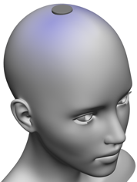
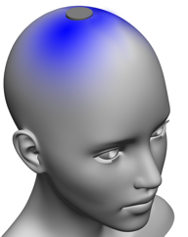
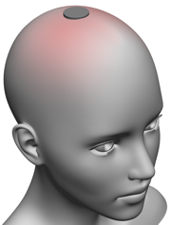
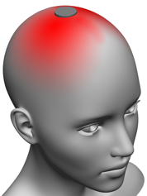
Understanding the EEG Signal
This simplified model shows how a single electrode tracks changes in scalp voltage over time as the underlying brain activity changes.
From “PURSUE Introduction to EEG/ERP”. [PowerPoint Presentation] by C. M. Bukach, J. W. Couperus, & C. L. Reed, 2020, www.pursueerp.com. CC BY-NC-SA.
Notes:
Here we will demonstrate how a single electrode tracks changes in scalp voltage over time as the underlying brain activity changes.
First, lets look at how the scalp distribution changes over time as a single negative neural dipole is followed by a positive dipole.
*Click. Blue represents a negative voltage, and red represents a positive voltage.
Now lets look at what the EEG date look like as it measures these voltage changes from a an active electrode at the top of the scalp.
*Click. First lets examine the axes. The y-axis represents voltage, with positive up and negative down. The x-axis represents time. *Click. Each datapoint or dot in the waveform represents a time when the voltage was sampled and recorded. As the scalp distribution changes over time, the EEG signal becomes more negative or more positive, resulting in a wave-like set of data.
NOTE: This is a simplified hypothetical model – real brain activity is much more complex, and there are multiple neural dipoles that overlap in time.
Image Credits:
Electrodes measure changes in scalp voltage over time. From Scalp voltages [Image] by L. L. Hensley, C. M. Bukach, J. W. Couperus, & C. L. Reed, 2020, PURSUE Project. CC BY-NC-SA 4.0.

Slide 19
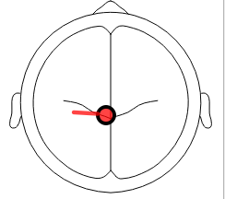


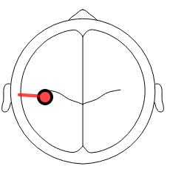
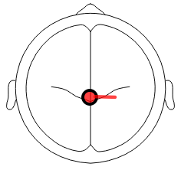
Understanding the EEG Signal
The strength and polarity of the signal at each electrode depends on
LOCATION OF ELECTRODES
DISTANCE FROM THE NEURONAL DIPOLE
ORIENTATION OF DIPOLE
From “PURSUE Introduction to EEG/ERP”. [PowerPoint Presentation] by C. M. Bukach, J. W. Couperus, & C. L. Reed, 2020, www.pursueerp.com. CC BY-NC-SA.
Notes:
Each electrode produces a unique waveform signal. The strength (amplitude) and polarity (positive versus negative) of the signal depends on several factors.
*CLICK. The location of the electrodes – Because the voltage is distributed over the scalp, the EEG signal from a particular electrode will depend on where the electrode is placed. In other words, the EEG signal will depend on the scalp voltage at the electrode’s location. (NOTE: you could mention both active and reference electrodes if you have already introduced these concepts).
*CLICK. The distance of the neural dipole from the scalp. Because the signal dissipates as it travels, the signal is stronger closest to the source.
*CLICK. The Orientation of the neural dipole. The orientation of the dipole determines the voltage distribution on the scalp. The orientation of the pyramidal cells depends on how the cortex is folded to fit within the brain. The polarity of the dipole also depends on whether the post synaptic potential is excitatory or inhibitory, and whether the post synaptic potentials are closer to the dendrites or to the cell bodies. All of these things will affect the voltage distribution on the scalp and the EEG signal.
OPTIONAL: Interactive Simulations. To better understand how these factors influence the EEG waveform, instructors can use the interactive simulations as an in-class demo, in-class activity, or as homework.
ALTERNATIVE ACTIVITY: Have students download the free besa simulator at https://www.besa.de/downloads/besa-simulator/
Image Credits:
Heads with dipole position. Adapted from standard graphical output from "BESA Simulator v1.4," [Computer Software] by BESA® GmbH - Germary, 2019, (https://www.besa.de/downloads/besa-simulator/). Copyright [2019] by BESA® GmbH - Germany.

Slide 20
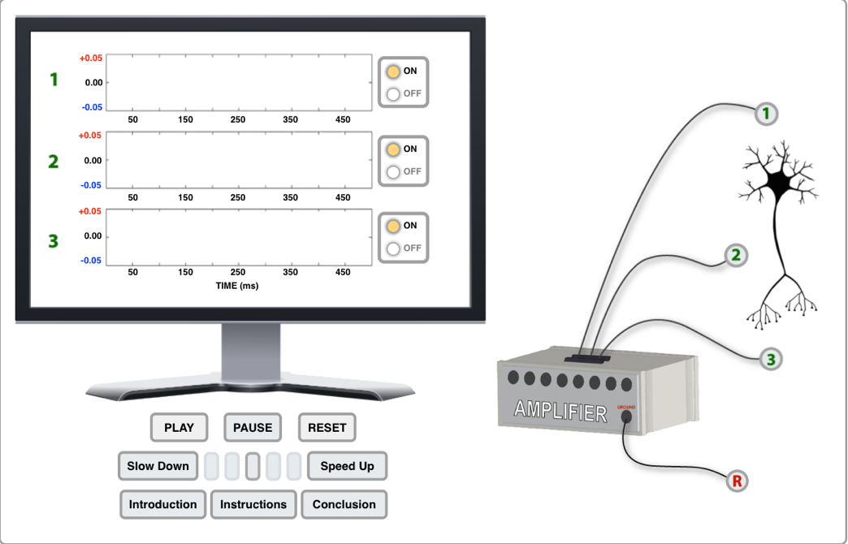
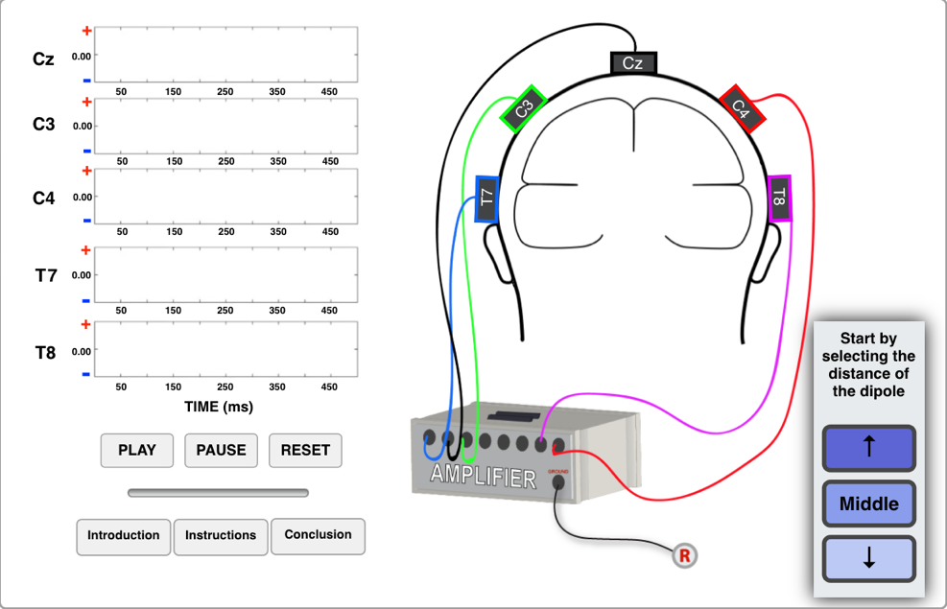
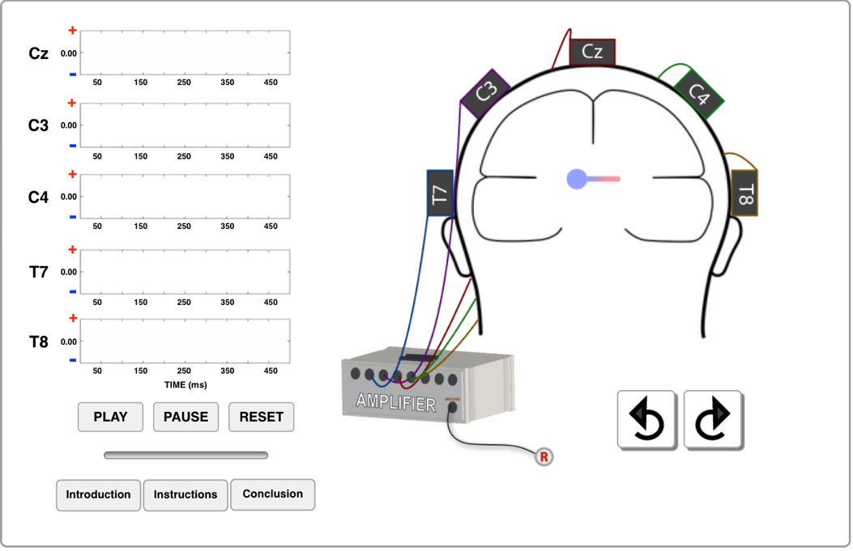
Simulations!
Please work through each of these simulations before tomorrow and come back with any questions.
If you run into problems, or, if you reach any insights, please post on slack on the #training channel
Simulation 1: Electrode Location with Single Neuron
Simulation 2: Distance of the Dipole from the Scalp
Simulation 3: Orientation of the Dipole
https://pursue.richmond.edu/multimedia-tools/interactive-simulations/simulation-1/
https://pursue.richmond.edu/multimedia-tools/interactive-simulations/simulation-2/
https://pursue.richmond.edu/multimedia-tools/interactive-simulations/simulation-3/
Adapted from “PURSUE Introduction to EEG/ERP”. [PowerPoint Presentation] by C. M., J. W. Couperus, & C. L. Reed, 2020, www.pursueerp.com. CC BY-NC-SA. Bukach

Slide 21
Interim summary
The EEG signal recorded on the scalp is a direct measure of brain activity
Individual pyramidal cell neurons form small dipoles when depolarized (post-synaptic potentials). But, these dipoles are too weak to measure on the scalp.
When thousands of neurons are aligned in the same direction, and simultaneously active, they form larger dipoles that propagate electromagnetic radiation to the scalp (via volume conduction).
EEG activity measured on the scalp reflects the summation of multiple active dipoles at any given point in time.
EEG has poor spatial resolution, but excellent temporal resolution.

Slide 22
How do we use EEG?

Slide 23
Cognitive Neuroscience Links BRAIN to the Cognitive Processes Underlying Behavior
Brain
Cognitive
Processes
Behavior
“There’s a bear behind you”
B
Localize
Bear
A
Motor Output “Run!”
Understand
Words
D
C
Recognize
Bear
Adapted From “PURSUE Introduction to EEG/ERP”. [PowerPoint Presentation] by C. M. Bukach, J. W. Couperus, & C. L. Reed, 2020, www.pursueerp.com. CC BY-NC-SA.

Slide 24
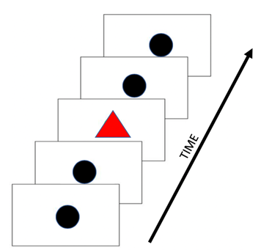
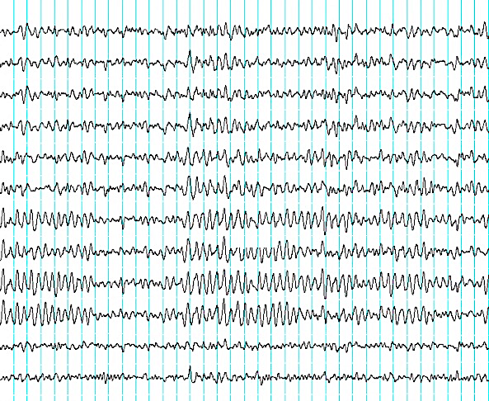
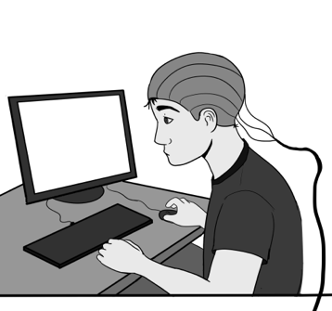
ERPs Indicate Cognitive Processes
ERPs (Event-Related Potentials) are electrical potentials elicited by an event (e.g., stimulus or subject response). By time-locking the event to the EEG signal, we can study the timing and organization of cognitive processes related to the event.
Target-related activity
Perception
Attention
Categorization
Response
Target appeared
EVENT
EEG
ERP
From “PURSUE Introduction to EEG/ERP”. [PowerPoint Presentation] by C. M. Bukach, J. W. Couperus, & C. L. Reed, 2020, www.pursueerp.com. CC BY-NC-SA.
Notes:
One method is to compute erps. We do a lot more than computing erps in our lab, but we will leave those other features (time frequency, source localization, etc for the analysis lectures later this semester and next)
EEG are spontaneous electrical potentials generated by the brain. But to study cognitive processes related to specific events, we need to time-lock the signal to an event.
*Click. Event-Related Potentials, or ERPs for short, are electrical potentials are elicited by an event. The event can be something that happens in the environment, or a response that a participant make in an experiment. Because ERPs are time-locked to the event, they allow us to study the timing and organization of specific cognitive processes related to the event.
*Click. For example, if we are interested in the cognitive processes associated with target recognition, we might conduct an experiment that shows rare targets (red triangles) among frequent black circles (non-targets), while we record EEG. The participant must press a different button for targets than non-targets.
*Click. A trigger is sent to the EEG datafile that marks the onset of the stimulus, or “time 0”, the time at which the stimulus appeared.
*Click. We can then take a segment or window of the data following the stimulus onset to examine brain activity related to target processing. In our example, this might include perceptual processing (encoding the structural properties of the shape), attention (focusing on the correct features), categorization (recognition that it is a target), and response preparation, execution and monitoring.
But there’s a problem – the ERP from a single trial doesn’t usually look like this…
Image Credits:
ERP study events. From Time locked ERP study design [Image], by C. M. Bukach, J. W. Couperus, & C. L. Reed, 2020. CC BY-NC-SA 4.0.
Participant in ERP study. From ERP method [Image] by E. Hagen, C. L. Reed, C. M. Bukach, & J. W. Couperus, 2018. CC BY-NC-SA 4.0.
EEG data. From Raw EEG data (12 channels) [Image], by C. M. Bukach, J. W. Couperus, & C. L. Reed, 2020. CC BY-NC-SA 4.0.
ERP waveform. From ERP data [Image], by C. M. Bukach, J. W. Couperus, & C. L. Reed, 2020. CC BY-NC-SA 4.0.

Slide 25
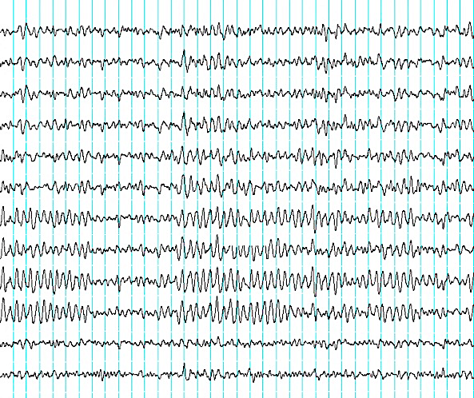
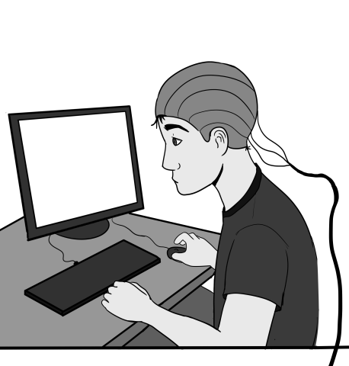

PROBLEM: Signal + Noise
Spontaneous EEG (noise) occurs at the same time as the event-related signal.
Metabolic regulation
Muscle Movements
Talking from the next room
Remembering I forgot to feed cat
Thinking about my exam tomorrow
Target-related activity
Perception
Attention
Categorization
Response
Target appeared
From “PURSUE Introduction to EEG/ERP”. [PowerPoint Presentation] by C. M. Bukach, J. W. Couperus, & C. L. Reed, 2020, www.pursueerp.com. CC BY-NC-SA.
Notes:
It looks like this!
The EEG signal contains both the signal related to the event you are interested in, along with everything else your brain is doing at the time. This might include things like
*Click. Metabolic regulation so you can digest your food and use the nutrients to fuel your cells
*Click. Muscle Movements
*Click. Talking from the next room – even if you are trying to ignore it!
*Click. Remembering that you forgot to feed the cat
*Click. Thinking about the exam you need to take tomorrow.
All of these things will result in brain activity that is also present in the EEG waveform! The brain activity that is unrelated to the event is called “noise”.
Image Credits:
Participant in ERP study. From ERP method [Image] by E. Hagen, C. L. Reed, C. M. Bukach, & J. W. Couperus, 2018. CC BY-NC-SA 4.0.
EEG data. From Raw EEG data (12 channels) [Image], by C. M. Bukach, J. W. Couperus, & C. L. Reed, 2020. CC BY-NC-SA 4.0.
Noise. From Noise in EEG signal, created using BESA Simulator v1.4 [Image], by C. M. Bukach, J. W. Couperus, & C. L. Reed, 2020. CC BY-NC-SA 4.0.

Slide 26

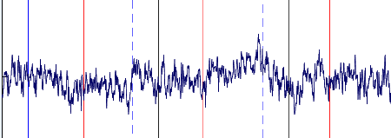
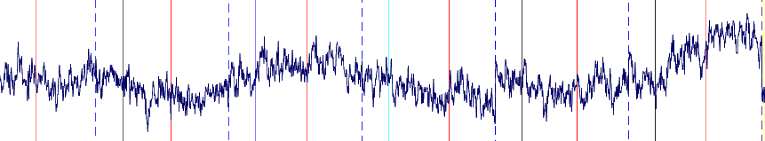
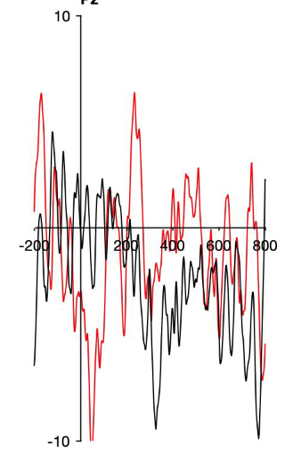
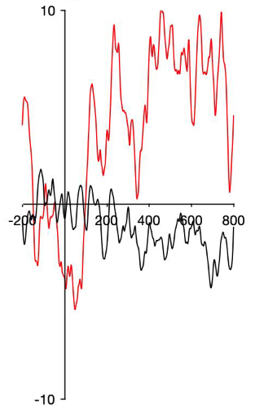
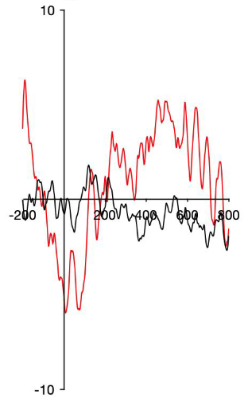
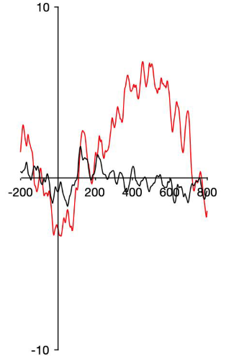
Solution: Average Signals
To increase the signal-to-noise ratio, ERPs are averaged over repeated trials of the same type.
EEG Segments
Trial 1
Trial 2
Trial 3
ERP Averages
3 trials
10 trials
20 trials
40 trials
From “PURSUE Introduction to EEG/ERP”. [PowerPoint Presentation] by C. M. Bukach, J. W. Couperus, & C. L. Reed, 2020, www.pursueerp.com. CC BY-NC-SA.
Notes:
To increase the signal to noise ratio, we can present multiple trials in each condition and average the ERP segments together for each trial type.
Recall that in our sample experiment, there are two types of trials – non-target trials showing black circles, And rare target trials showing red triangles.
We would create two ERPs - one that averages all of the black non-target trials, and one that averages all of the red target trials.
At the top, you see segments of the EEG data for 3 trials –
*CLICK: 2 non-target trials
*CLICK: and one target trial.
At the bottom, you see an ERP plot. The black line is the average waveform of the two non-target EEG trials, and the red line is the single trial of the target trial.
QUESTION: Can you tell whether there is a difference between processing targets and non-targets?
The data are too messy to be sure.
NOTE:
There are two OPTIONAL Class activities. See below for Notecard Activity. See additional instructor support materials for the Waveform Averaging Activity which requires students to average simple waveforms to guess the true signal, which can be done in class or as an assignment. If doing the note-card activity, wait to click through the slide animations until after the activity
Let’s see what happens when we increase the number of trials to
*Click 10,
*Click 20,
*Click and even 40 trials!
QUESTION: Why do you think the signal gets less noisy when we average the trials?
ANSWER: As the number of trials increase, the data look more and more like the true signal because the asynchronous noise is canceling out. Because the ERP wave is synced to the event, the signal has roughly the same shape and timing across trials, and therefore the signal stays consistent when they are averaged together. Because the noise is random and is not synced with the onset of the trial, the shape and timing of the noise varies over trials thus the noise gets weaker during averaging (e.g., noisy peaks will cancel noisy troughs if they are aligned).
NOTECARD ACTIVITY:
Let’s try an activity to give you a sense of how this works.
>>Give students 4 x 6 cards. The first word on the card is different on every card. The second word is the same on 20% of the cards. The 3rd word is the same on 50% of the cards.
When you came in today you were given a card with 3 words on it.
When I say “GO” I want each of you to say aloud the first word.
What did you hear? If you wanted to hear your word better, what would you have to do?
Now, when I say “GO”, I want each of you to say aloud the second word.
What did you hear? Did you hear one word a little better?
OK, when I say “GO”, I want each of you to say aloud the third word.
What did you hear? Why could you hear that word better?
Now click through the slides to show how the signal emerges as you add more trials.
Image Credits:
EEG Segments. From EEG segments over multiple trials [Image], by C. M. Bukach, J. W. Couperus, & C. L. Reed, 2020. CC BY-NC-SA 4.0.
ERP Averages. From ERP averages over 3, 10, 20 and 40 trials [Image], by C. M. Bukach, J. W. Couperus, & C. L. Reed, 2020. CC BY-NC-SA 4.0.

Slide 27
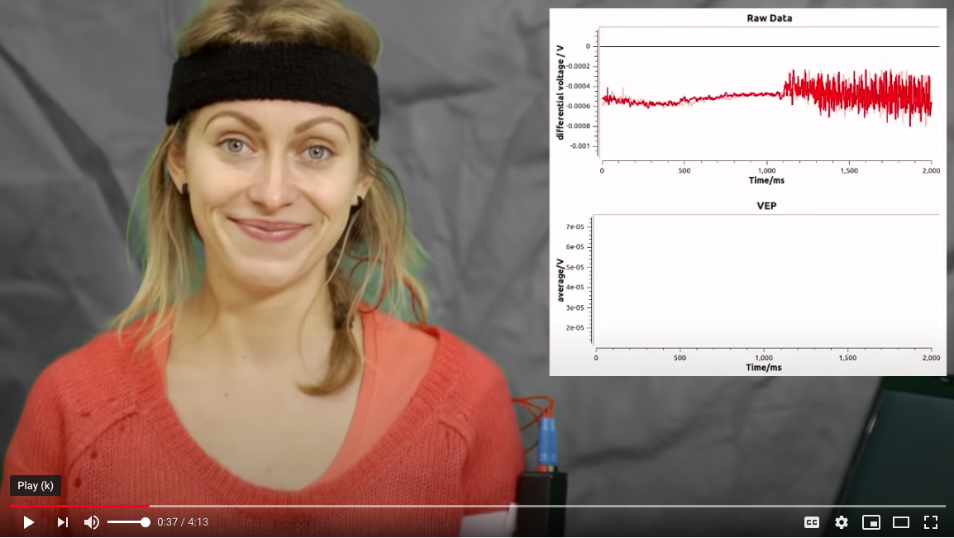
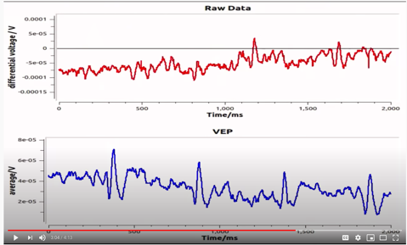
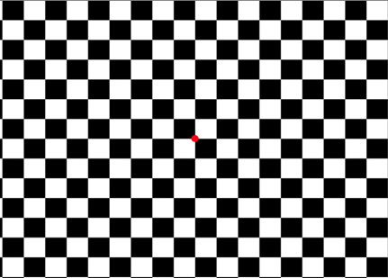
Video Example of ERP Averaging
https://www.youtube.com/watch?v=iXXxL0EOJqs
Adapted From “PURSUE Introduction to EEG/ERP”. [PowerPoint Presentation] by C. M. Bukach, J. W. Couperus, & C. L. Reed, 2020, www.pursueerp.com. CC BY-NC-SA.
Notes:
OPTIONAL SLIDE: This video clip shows the raw eeg (top frame) plus a building average (bottom frame) in response to a flashing checkerboard. The checkerboard flashes at 2 hz, which means that it flashes twice per second, or every 500 ms. The data window is 2 seconds long, so it will flash 4 times in the EEG/ERP window.
Image Credits:
Video example of ERP averaging. From Visually evoked potentials (VEP) [Video] by V. Georgiadou, & B. Porr, 2013 (https://youtu.be/iXXxL0EOJqs). CC BY-NC-SA 4.0.
Raw EEG and building averages. From Visually evoked potentials (VEP) [Video] by V. Georgiadou, & B. Porr, 2013 (https://youtu.be/iXXxL0EOJqs). CC BY-NC-SA 4.0.
Checkerboard flashing at 2hz. From Visually evoked potentials (VEP) [Video] by V. Georgiadou, & B. Porr, 2013 (https://youtu.be/iXXxL0EOJqs). CC BY-NC-SA 4.0.

Slide 28

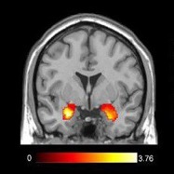
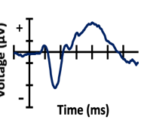
Comparison of Methods
WHAT
Links cognition to behavioral outcome of brain activity
WHERE
Links cognition to location of brain activity
WHEN
Links cognition to timing of brain activity
Behavioral Methods
Functional Imaging Methods
EEG/ERP Methods
Adapted From “PURSUE Introduction to EEG/ERP”. [PowerPoint Presentation] by C. M. Bukach, J. W. Couperus, & C. L. Reed, 2020, www.pursueerp.com. CC BY-NC-SA.
Notes:
A variety of methods help us understand behavior and the cognitive and neural processes that underlie our behavior. Each methodological approach tells us something slightly different, and converging methods help us to build a more complete understanding.
1. *CLICK. Behavioral studies are great for studying questions about WHAT behavioral effects exist, and for testing cognitive models that link cognition to behavior.
2. *CLICK. Functional imaging studies such as fMRI are great for studying questions about WHERE cognitive processes are happening in the brain, and their neural connections.
3. *CLICK. EEG/ERP methods are great for asking questions about WHEN cognitive processes occur, and for linking cognitive processes to brain activity
Image Credits:
Behavioral Methods. From Competition race sport run [ClipArt] by [Peggy_Marco], n.d., Pixabay (https://pixabay.com/illustrations/speech-balloon-talk-bubble-1019777/). CC0 1.0.
Functional Imaging Methods. From Amygdala activation [Image] by G. Konstantina, 2017, Wikimedia Commons (https://en.m.wikipedia.org/wiki/File:Amygdala_activation.jpg). CC BY-SA 4.0.
EEG/ERP Methods. From ERP data [Image], by C. M. Bukach, J. W. Couperus, & C. L. Reed, 2020. CC BY-NC-SA 4.0.

Slide 29

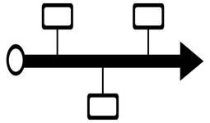

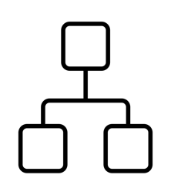

Advantage of EEG/ERP over Behavior Alone
Mental States
Time course of Cognitive processes
Organization of Cognitive Processes
No Response Required
From “PURSUE Introduction to EEG/ERP”. [PowerPoint Presentation] by C. M. Bukach, J. W. Couperus, & C. L. Reed, 2020, www.pursueerp.com. CC BY-NC-SA.
Notes:
QUESTION: Now that you have had an overview of what EEG and ERP methodologies are, what are some advantages that EEGs and ERPs have over doing a simple behavioral experiment?
ANSWER: Behavior gives us the outcome of a cognitive processing stream. With EEG, we get a window into the processes that lead to that behavior. For example,
1. *CLICK. We can study a person’s mental state and unconscious processes, without relying on self-report. We can tell how relaxed they feel, and even what stage of sleep they are in.
2. *CLICK. We can study the timing of cognitive processes
3. *CLICK. and test hypothesis about how the processing stream is organized.
4. *CLICK. Another huge benefit is that participants don’t even have to make a response – they can passively view or listen to a stimulus, and we can study how their brain responds. This is particularly great for studying unconscious processes and responses that people try to control or hide, such as racial and gender bias.
Image Credits:
Mental States: silhouette of a head. Silhouette of a head. From SVG > broken person computation triangles [Online Image] by SVG SILH, n.d. (https://svgsilh.com/image/2147328.html). CC0 1.0.
Mental States: sleep symbol. Sleep symbol. From Zzz (sleep) icon [Online Image] by [Perhelion], 2014, Wikimedia Commons (https://upload.wikimedia.org/wikipedia/commons/d/dd/Zzz_sleep.svg). Public Domain.
Organization of Cognitive Processes. From flowchart [Online Image] by [Random Panda, GB], n.d., The Noun Project (https://thenounproject.com/term/flowchart/1049513/). CC BY 3.0.
Time Course of Cognitive Processes. From timeline [Image] by [Cavanaugh Richards], n.d., The Noun Project (https://thenounproject.com/icon/656040/). Public Domain.
No Response Required. From Switch hand button finger press by [Clker-Free-Vector-Images], n.d., Pixabay (https://pixabay.com/vectors/switch-hand-button-finger-press-46783/). CC0 1.0.

Slide 30




Advantage of EEG/ERP over Other Methods
Direct Measure of Brain Activity
High Temporal Resolution
Non-Invasive
Less Expensive
From “PURSUE Introduction to EEG/ERP”. [PowerPoint Presentation] by C. M. Bukach, J. W. Couperus, & C. L. Reed, 2020, www.pursueerp.com. CC BY-NC-SA.
Notes:
EEGs and ERPs also have several advantages over other brain imaging techniques, such as function magnetic resonance imaging (or fMRI).
*CLICK. For example, FMRI is a measure of blood flow to the brain, and is therefore an indirect measure of brain activity. In contrast, EEG/ERP is a direct measure of brain activity, because volume conduction of neural activity to the scalpl is virtually instantaneous.
*CLICK. This also means that EEG has very high temporal resolution (ms precision), whereas the fMRI is delayed by several seconds.
*CLICK. EEG/ERP is also non-invasive, meaning that the electrodes sit on the scalp, and nothing needs to be injected, as it does with Positron Emission Tomography
*CLICK. Finally, EEG is much less expensive than other imaging methods. The equipment costs are between $25 and $50 K, and it takes only dollars in disposables for each participant. In contrast, fMRI costs millions in infrastructure and equipment, requires a lot of professional staff, and costs around $800 - $1000 per participant.
Image Credits:
Direct Measure of Brain Activity. From Brainwave [Image] by [Simon Child, GB], n.d., The Noun Project (https://thenounproject.com/term/brainwave/74778/). CC BY 3.0.
Non-Invasive. From EEG Cap [Image] by [CIV], n.d., The Noun Project (https://thenounproject.com/term/eeg-cap/19246/). Public Domain.
High Temporal Resolution. From Timer or chronometer tool [Online Image] by [Freepik], n.d., flaticon.com (https://www.flaticon.com/free-icon/timer-or-chronometer-tool_49203). Copyright by Flaticon.
Less Expensive. From Dollar sign in circle [Image] by J. S. Glad, 2014, Wikimedia Commons (https://commons.wikimedia.org/wiki/File:Dollar_sign_in_circle_cleaned_(PD_version).svg). Public Domain.

Slide 31
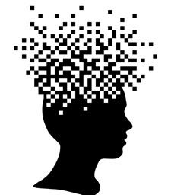

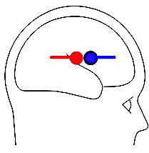
Limits of EEG/ERP
Poor Spatial Resolution
Limited measurement of non-cortical regions
Signals Can Cancel Each Other
Adapted fom “PURSUE Introduction to EEG/ERP”. [PowerPoint Presentation] by C. M. Bukach, J. W. Couperus, & C. L. Reed, 2020, www.pursueerp.com. CC BY-NC-SA.
Notes:
However, as with each method, EEG has limits in what it can measure.
1. *CLICK. It has poor spatial resolution because we are measuring brain activity that is summed at the scalp. While we can see differences in scalp topography that tells us something about the distribution of voltage, the neural signals are dispersed and summed. This means that the EEG method is not great for telling exactly where in the brain the signal is coming from. Some researchers do use sophisticated modeling to generate hypotheses about the sources of EEG activity, but fMRI has much better spatial resolution.
2. *CLICK. Some brain activity is not captured by the EEG signal. For example, it doesn’t measure activity in deep brain structures such as the thalamus, because the cells are randomly aligned.
3. *CLICK Rather, EEG captures the activity of pyramidal cells in the cortex. However, because the cortex has lots of folds, it is possible for signals to cancel each other out if their dipoles are facing in opposite directions.
Image Credits:
Poor Spatial Resolution. From Silhouette of human heal, pixel art stock illustration [Image] by M. Janecek, 2019, istockphoto (https://www.istockphoto.com/vector/silhouette-of-human-head-pixel-art-gm1173073441-325681841). Copyright [2019] by istockphoto.com.
Signals Can Cancel Each Other. From "BESA Simulator v1.4," [Computer Software] by BESA® GmbH - Germary, 2019, Brain Electrical Source Analysis (https://www.besa.de/downloads/besa-simulator/). Copyright [2019] by BESA® GmbH - Germany.
Doesn’t Measure Activity in Deep Brain Structures. From Silhouette brain logic [Image] by [monhamed_hassan], n.d., Pixabay (https://pixabay.com/vectors/silhouette-brain-logic-3576109/). CC0 1.0.
Complex Data Analyses. From Data Analysis on Display [Image] by Database Center for Life Science, 2018, Wikimedia Commons (https://commons.wikimedia.org/wiki/File:201806_DataAnalysis_on_display.svg). CC BY 4.0.

Slide 32
Interim summary
We are interested in isolating EEG activity associated with a given event (stimulus, response, context) of interest
While a single presentation of an event will produce a corresponding EEG response, the signal-to-noise ratio is far too low to reliably measure.
We typically repeat events of interest, and average EEG data together across trials to isolate event-related potentials (ERPs)
Pros of EEG: direct neural measure, high temporal precision, inexpensive (relatively), non-invasive and well-tolerated across development
Cons of EEG: poor spatial resolution, activity mainly arises from cortex only,

Slide 33
Digging deeper into what EEG is and how it is measured

Slide 34
ELECTROENCEPHALOGRAPHY (EEG)
EEG is a non-invasive, direct and continuous measure of the changes in electrical potentials at the scalp produced by neural activity in REAL time.
Brain Vision EEG System
Adapted From “PURSUE Introduction to EEG/ERP”. [PowerPoint Presentation] by C. M. Bukach, J. W. Couperus, & C. L. Reed, 2020, www.pursueerp.com. CC BY-NC-SA.
Notes:
EEG is a non-invasive, direct and continuous measure of the changes in electrical potentials at the scalp produced by neural activity in REAL time.
In this picture, you can see a picture of a participant wearing a cap with electrodes. Electrodes are connected to an amplifier that amplifies and records the signal at each electrode. Each electrode produces a its own data stream tracking changes in electrical signals at its scalp location, which is displayed on a computer screen.
Let’s briefly break down some key concepts in this definition:
EEG is Non-invasive: Electrodes are not inserted into the brain.
EEG Measures Scalp potentials: Electrodes are placed on the scalp and measure changes in electric signals at the scalp.
EEG is a direct measure of brain activity: The speed of electric transmission from brain to scalp is so fast that the time lag is negligible – thus it captures brain activity in real time.
EEG is a continuous Measure: EEG tracks changes in scalp potential over time.
These last two are key advantages of the EEG Method – it has very high temporal resolution so we can see millisecond changes in brain activity as it happens.
Image Credits:
Person wearing EEG cap connected to amplifier. From CapTrak and actiCHamp by BrainVision, n.d. (https://pressrelease.brainproducts.com/wp-content/gallery/1501/CapTrak_actiCHamp_01.jpg). Copyright by Brain Vision, LLC.
Computer monitor. From Computer monitor lcd screen blank by [Clker-Free-Vector-Images], n.d. (https://pixabay.com/vectors/computer-monitor-lcd-screen-blank-303283/). CC0 1.0.

Slide 35
Where does the EEG Signal Come From?
EEG Waveforms
Electrodes measure changes in scalp voltage over time
Scalp Distribution
Dipole potentials spread to scalp
Summation
Synchronous dipoles from aligned neurons summate
Dipoles
A difference of charge between two parts of the neuron
Postsynaptic
Potentials
Affect local ion concentrations surrounding the cell
From “PURSUE Introduction to EEG/ERP”. [PowerPoint Presentation] by C. M. Bukach, J. W. Couperus, & C. L. Reed, 2020, www.pursueerp.com. CC BY-NC-SA.
Notes:
Here we preview the basic steps of how neurons create electrical signals that are recorded by electrodes on the scalp. Then we will look at each stage in depth.
*CLICK. Post-synaptic Potentials: Neurons communicate through electro-chemical signals. Post synaptic potentials occur when a cell receives communication. Post synaptic potentials involve the exchange of charged ions between the outside and inside of the cell, creating a local changes in charge concentration in both the intracellular and extracellular fluid. For example, an excitatory PSP makes the inside of the cell more positive, as indicated in red, and the outside of the cell more negative, as indicated in blue.
*CLICK. The change of ion concentration in the extracellular fluid creates a difference in charge between the site of the Post synaptic potential and the cell body. This difference in charge creates a dipole and electrical current, similar to how a battery works.
*CLICK A dipole from a single neuron is not strong to be measured by EEG. Rather, it takes synchronous activity of an aligned cluster of cells to make a measurable EEG signal. The summed activity results in a large equivalent current dipole that can be symbolized as a circle that represents the location of the potential, and a line that represents the orientation of the dipole.
The dipole potentials disperses instantaneously through the brain and skull tissue and creates a distribution of charge on the scalp that reflects the underlying post synaptic activity. This process is called volume conduction and the result is a scalp distribution. NOTE for Instructor: The yellow lines represent equipotential lines, (voltage dispersion) not electrical field lines.
Electrodes placed on the scalp measure changes in scalp voltage over time that reflect the time course of cognitive processing. The top part of this image shows how the scalp distribution is changing over time, and the bottom graph shows the voltage value from a single electrode at each timepoint.
Resources for understanding the generation of the EEG Signal
Emilia Hagen’s 2018 Animation Links on YouTube/videos (~2-3 min videos)
Understanding potentials: https://youtu.be/0_boSag4f8g
Formation of a Dipole: https://youtu.be/rzgDOaGjjOs
Sensing dipoles: https://youtu.be/AIvlNNFQLEk
– these movies must be used and cited under the Creative Commons License with no modifications and no commercial use
Image Credits:
Postsynaptic potentials affect local ion concentrations surrounding the cell. From Postsynaptic potentials at dendrites of pyramidal neuron [Image] by L. L. Hensley, C. M. Bukach, J. W. Couperus, & C. L. Reed, 2020, PURSUE. CC BY-NC-SA 4.0.
A difference of charge between two parts of the neuron forms a dipole. From A pyramidal neuron forms a dipole [Image] by L. L. Hensley, C. M. Bukach, J. W. Couperus, & C. L. Reed, 2020, PURSUE Project. CC BY-NC-SA 4.0.
Synchronous dipoles from aligned neurons summate. From Many pyramidal neuron dipoles summate
[Image] by L. L. Hensley, C. M. Bukach, J. W. Couperus, & C. L. Reed, 2020, PURSUE Project. CC BY-NC-SA 4.0.
Dipole potentials spread to scalp. From Spread of signal from dipole to scalp [Image] by L. L. Hensley, C. M. Bukach, J. W. Couperus, & C. L. Reed, 2020, PURSUE Project. CC BY-NC-SA 4.0.
Electrodes measure changes in scalp voltage over time. From Scalp voltages [Image] by L. L. Hensley, C. M. Bukach, J. W. Couperus, & C. L. Reed, 2020, PURSUE Project. CC BY-NC-SA 4.0.

Slide 36


EEG
Changes in voltage across the scalp
Measured using electrodes
These electrodes pick up electrical activity generated in the brain, but also other “noise”
To understand EEG, and properly interpret it, we need to know:
What electricity is
How voltage is measured
What (in the brain) generates voltage changes on the scalp

Slide 37

What is electricity?
The water pipe analogy:
Water pressure is like Voltage
The ”force” that “pushes” water molecules through the pipe
Voltage is how much an electron wants to go from A to B
The volume of water flowing at any point is like current
The rate that water molecules pass through a section of pipe
Current is the rate of electrons going from A to B
Pipe blockage is like resistance
A smaller pipe restricts the rate of water flow through the pipe
Resistance reduces the electrical current “flowing”

Slide 38
What is electricity?
Voltage, current and resistance are related, just like water volume, pipe size, and pressure
If the volume of water stays constant, but the pipe blockage increases, then the pressure must also increase
E.g. putting finger on hose increases pressure
If current (flow of electrons) stays constant, but resistance (blockage) increases, then voltage (force) also increases

Slide 39


AC/DC
Alternating current (AC)
Electrical activity that changes over time (oscillates, like a wave)
Like wall outlet
Direct current (DC)
Electrical activity that is stable over time (constant, flat)
Like batteries
EEG electrodes pick up both AC and DC, but brain activity is AC (we think…)
For AC, impedance is basically the same as resistance (for the most part…)
Impedance is actually a combination of resistance, capacitance/inductance, and depends on the specific frequency. But, don’t worry about that, it is fine to think impedance ~= resistance
Notes:
a) Capacitance: The amount of charge that can be stored inside a capacitor at a given voltage is called Capacitance. It gets charged when charges are forced into the positive (or upper) plate of the capacitor due to emf. Similarly, it discharged when charges are forcefully pulled out of the capacitor. Capacitance is measured in Farad. b) Inductance: It is the property of a coil to resist any change in electric current flowing through it. Self inductance is caused when a coil resists the current change through itself. Mutual inductance occurs when a secondary coil opposes current change in a primary coil. Inductance is measured in Henry. c) Resistance: It is the property of a material which opposes the flow of electric current through it. Conductors have low resistance while insulators have very high resistance. It is measured in Ohms.

Slide 40
How is EEG voltage measured?
Because voltage is the likelihood of an electron to move from A to B, voltage is, by definition, a relative measure between two points
If we want to measure voltage at electrode B on the scalp, we need reference electrode A
Voltage at electrode B is relative to reference electrode A
What is measured at each electrode is the difference in voltage between the electrode site and the reference site

Slide 41
The reference matters
Anything common between the electrode location and reference location is subtracted out
This includes brain activity at the reference site!
There is no location on the head that does not measure brain activity
Changing the reference changes what brain activity you can “see”
Changing reference changes how your data looks

Slide 42
Interim summary
Electricity is described by voltage (pressure), current (volume), and resistance (blockage)
Impedance is basically resistance for AC
EEG reflects changes in voltage, recorded on the scalp between a given electrode and the reference electrode

Slide 43



Environmental noise
The circuit formed by electrode B and reference A doesn’t just pick up unique brain activity at the electrode location
A-B circuit picks up lots of stuff:
Brain activity
Physiological noise
Environmental noise (electromagnetic radiation in the room)
We will talk later physiological noise, what causes the environmental (electrical) noise in the room?

Slide 44

Environmental noise
Electrical current generates magnetic fields at 90 degree angle
Magnetic fields generate electrical fields at 90 degree angle
All electrical equipment and cords, if unshielded, give off EF radiation
Common sources: lights, monitor, cords, wiring in walls, computers
Where possible, identify and remove sources of noise

Slide 45


Reducing noise
Ideal recording set-up:
Electrically shielded participant room
All computers and nearly all other electrical devices, cords, etc. outside of participant room
Cords and equipment inside participant room are shielded
If can’t shield wires, at least do not let them coil/tangle!
LED monitor and lighting
No metal contacts with participant
No personal electronics in room

Slide 46

The ground electrode
For noise sources we cannot remove, what can we do reduce the effect of these noise sources on our recorded EEG?
Need to measure it, and subtract it out!
The ground electrode allows us to measure/remove E noise
Voltage between the reference and the ground will pick up environmental noise
Subtracting ground->reference activity (E noise) from reference-> electrode activity (brain/pysio + E noise) removes E noise
Common mode rejection: rejecting common electrical activity

Slide 47

Why impedance matters
If the ground->reference circuit picks up E noise and this is subtracted from the reference->electrode circuits, why do we still see some E noise in recorded EEG?
Common mode rejection assumes similar measurement at the electrode, reference, and ground
Measurement is highly influenced by impedance!
This is why it is critical to lower impedance levels, to ensure the ability to reject E noise when recording

Slide 48
Interim summary
EEG electrodes pick up neural activity, physiological artifacts, and environmental noise
We are careful to reduce environmental noise as much as possible in terms of room set up
Common mode rejection (subtracting what is common in the ground-ref and electrode-ref circuits) can help to remove additional environmental noise
Lower impedance results in better rejection of environmental noise

Slide 49
Questions?
Next up: Our EEG Systems

